Slide 1


NITTE MEENAKSHI INSTITUTE OF
TECHNOLOGY
YELAHANKA BENGALURU-560064
Department of Electrical and Electronics Engineering
INTERNET SPEED TEST USING PYTHON
Under the guidance of
Dr Samanvitha (Associate Professor)
Department of Electrical and Electronics Engineering
NMIT
Project by
SANJANA CHAUHAN USN- 1NT21EE054

Slide 2
CONTENTS
INTRODUCTION
OBJECTIVE
METHODOLOGY
OUTPUT
CONCLUSION
REFERENCES

Slide 3
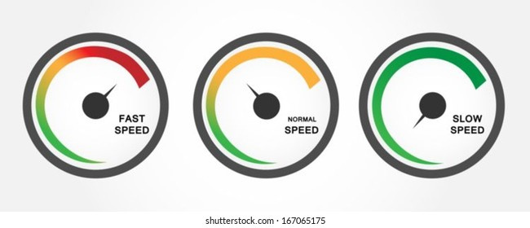
INTRODUCTION
Internet speed is critical to your business. A slow internet or wifi connection can tax your productivity,profit and patience. And you don’t want to pay for internet speeds that you are not actually getting. For these reasons, it’s a good idea to periodically check your internet speed.
Numerous websites are available that will test your internet speed. You can find one good at ‘https://www.speedtest.net/’. It allows you to check internet speed very easily and quickly in terms of download and upload speed.

Slide 4
I found that some people need faster internet because of the way they use it. If you do a lot of things on the internet, you will need a faster speed, so you can do multiple things at once without being slowed down.
A lot of things use the home internet connection. One of them is the phone. The VOIP phone uses the internet to make phone calls instead of telephone wires. A Microcell uses the internet to route cell phone traffic so you can get a better signal at home.
Any streaming video service plays movies over the internet. If you want to be able to watch a Netflix movie without buffering, you should get a faster speed.
When your internet speed is slow and you want to determine the cause ,diagnose Issues with your connection. It would be useful to test the speed in a variety of conditions.

Slide 5
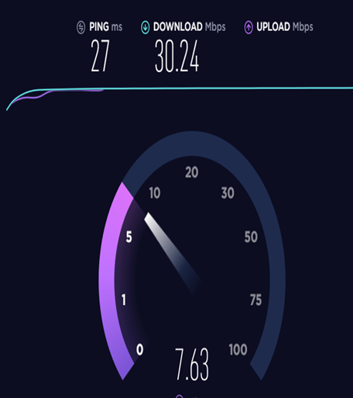
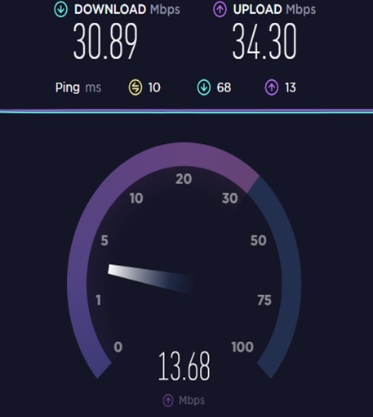
What is the Difference Between Upload and Download Speeds?
Another confusing thing about shopping for internet is when you see speeds listed like this: 5/1 Mbps. Well, that means that internet plan has a download speed of 5 mbps and an upload speed of 1 mbps.
The reason why your upload and download speed are different is because most internet connections are asymmetric. In English this means that the bandwidth is a different size going one way compared to the other. Since most users consume content rather than upload it, the bandwidth for download speeds is larger (than the upload).

Slide 6
Factors Affecting Internet Speed
Internet Service Provider (ISP):
Plan: The internet speed you receive is often determined by your chosen subscription plan. Higher-tier plans typically offer faster speeds.
Network Congestion: During peak usage hours, ISPs may experience network congestion, leading to slower speeds for users.
Network Type:
Fiber-Optic: Fiber-optic connections generally offer faster speeds compared to DSL or cable connections.
DSL (Digital Subscriber Line): DSL speeds can vary based on distance from the provider's central office.
Cable: Cable internet can provide high speeds but may slow down during peak usage times.

Slide 7
3.Distance from Server:
The physical distance between your device and the server or website you're connecting to can affect latency (ping) and download speeds. Longer distances can result in slower connections.
4.Time of Day:
Internet speed can vary depending on the time of day. Peak hours, when more users are online, may result in slower speeds.
5.Weather Conditions:
Extreme weather conditions, such as heavy rain or snow, can damage infrastructure and impact internet connectivity.

Slide 8
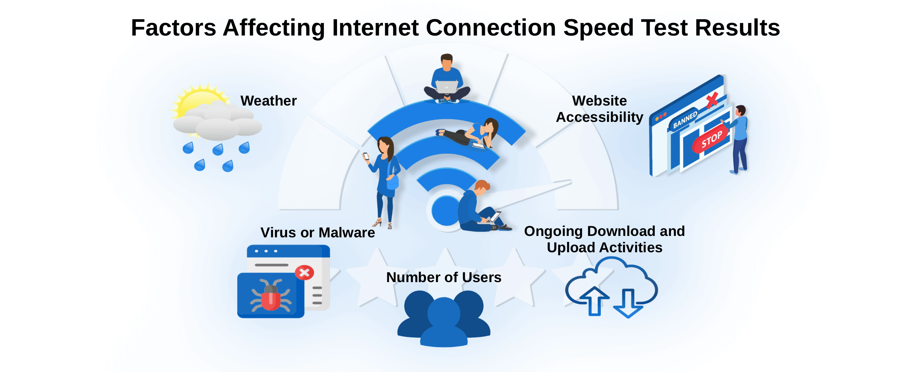

Slide 9
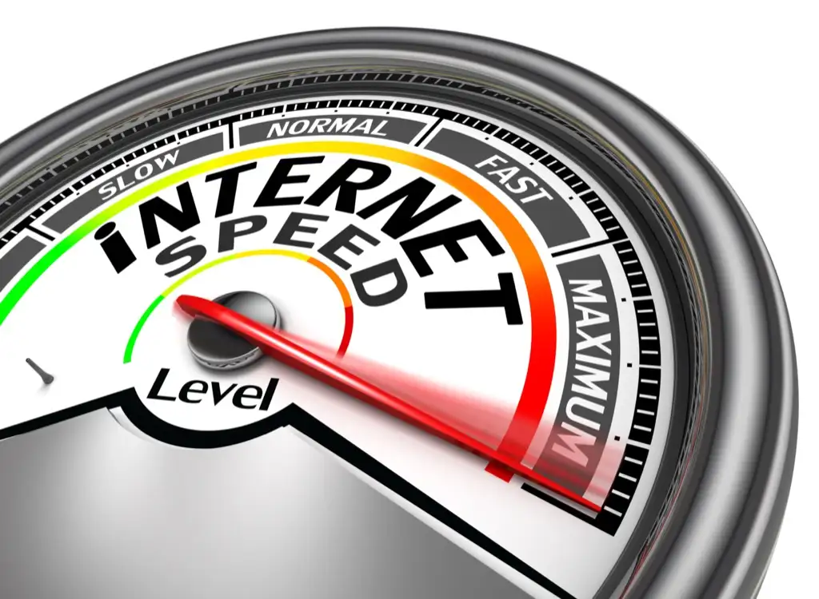
OBJECTIVE
The objective of this project is to check the internet speed which includes both download speed and upload speed.
The speed test can be conducted by an end-user to determine the upload and download speed of a network. It can be mobile data network or WIFI.
The download and upload speed is usally measured in Mbps.

Slide 10
What is GUI?
A graphical user interface (GUI) is a digital interface in which a user interacts with graphical components such as icons, buttons, and menus. In a GUI, the visuals displayed in the user interface convey information relevant to the user, as well as actions that they can take.
GUIs make software more user-friendly and intuitive by providing a visual representation of the application's functionality.

Slide 11
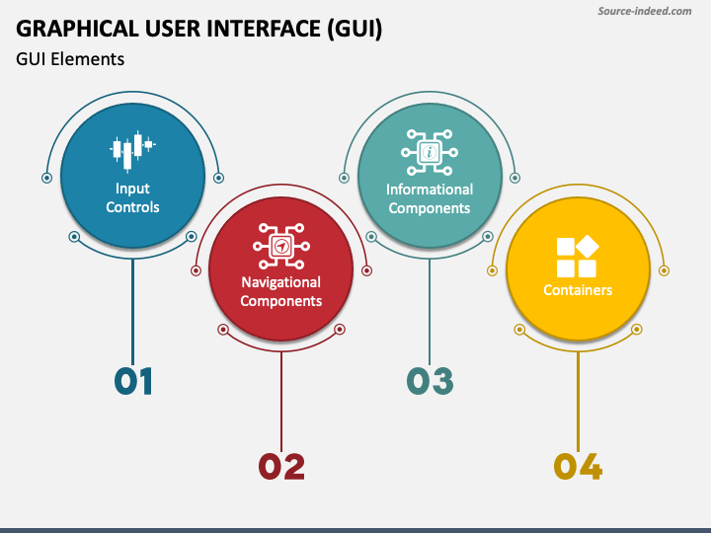

Slide 12
METHODOLOGY
We begin with installing the required libraries using the pip package manager.
We need to install tkinter and speedtest-cli libraries.
After installing the required libraries from the terminal, we now move to our Python file to code. We start with importing the libraries :
As a next step, we initialize our GUI window using the Tkinter module. This step describe the basic outlook of our app.
In our code, we will be using Speedtest-cli package to get the internet bandwidth using speedtest.net
We then add functionality to our code. This part is the most crucial in getting correct internet speed information.
We now start to code the elements as per the GUI, for heading, text, labels, buttons, etc.
On execution of our code, the Tkinter displays the output

Slide 13
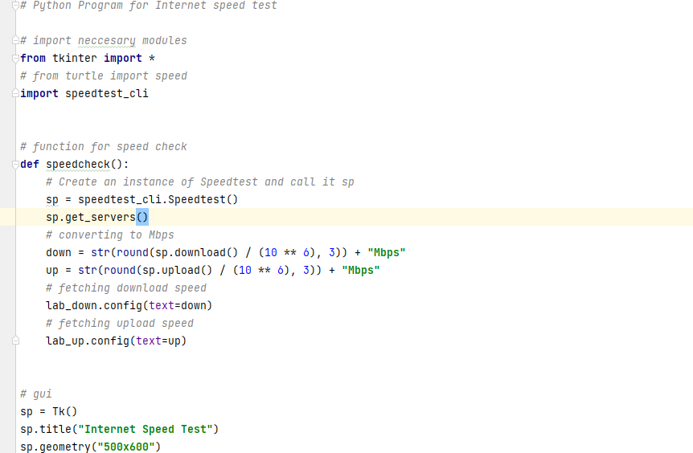
CODE

Slide 14
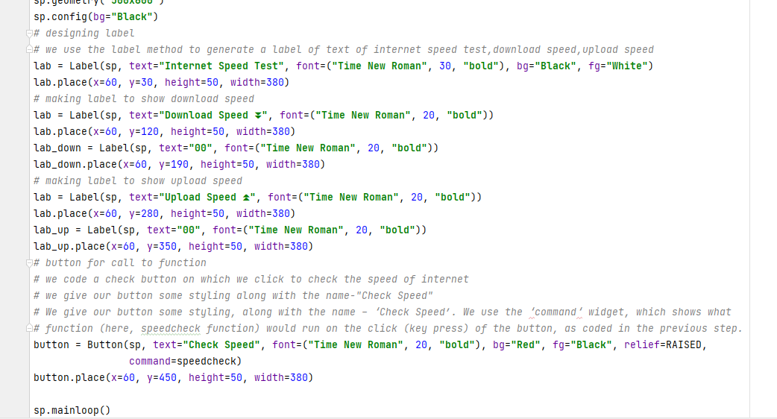

Slide 15
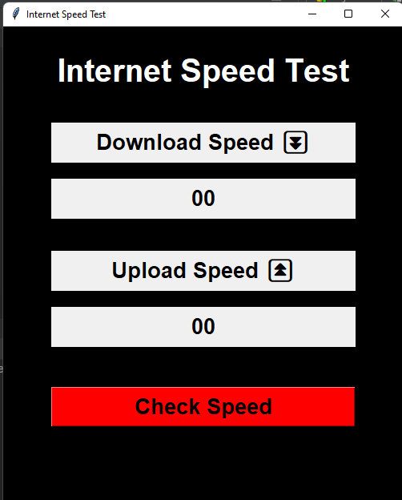
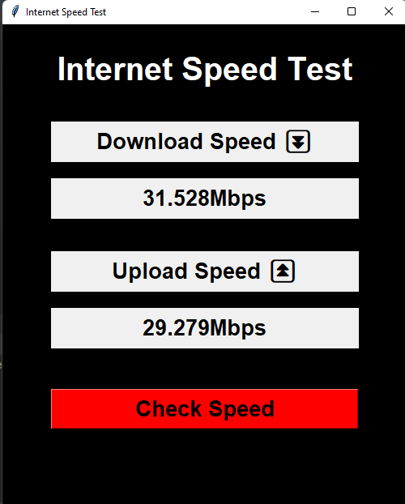
OUTPUT
Click on the button “check speed” to get the internet speed

Slide 16
CONCLUSION
I learned how to create a GUI (graphical user interface) environment. I used it to create a simple internet speed test app in python.
Internet speed test allows us to effectively measure and analyze the performance of our internet connection.
It will give you real world broadband bandwidth results , ping test and more.
The download and upload speed test will provide you with a average internet speed test.

Slide 17
REFERENCE
https://www.programiz.com/
https://www.geeksforgeeks.org/how-to-test-internet-on-linux-using-speedtest-cli/?ref=gcse
https://thecleverprogrammer.com/2021/06/23/internet-speed-test-using-python/
https://www.educative.io/answers/how-to-detect-internet-speed-using-python
https://github.com/sivel/speedtest-cli
https://www.speedtest.net/

Slide 18


